Slide 1

Beat Boxers
Burns Clark-McKay

Slide 2
Music + Motion = Good

Slide 3

Music + Motion = Good

Slide 4
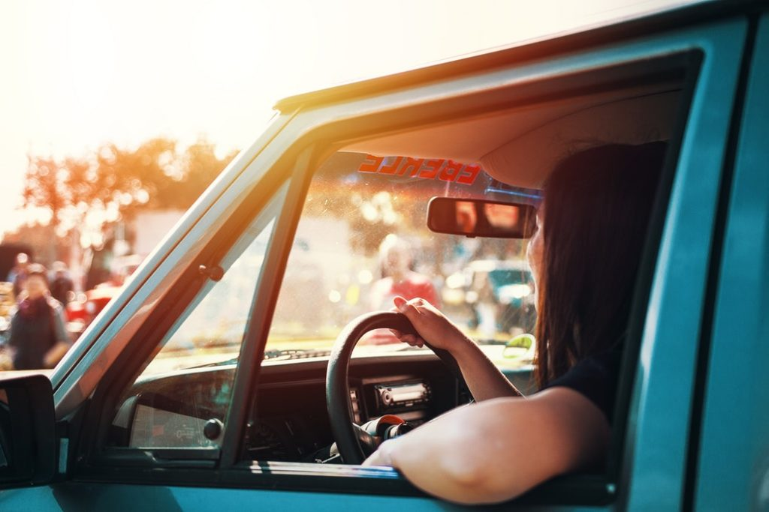
Music + Motion = Good

Slide 5

Music + Motion = Good

Slide 6
Music + Motion = Good
Now what?

Slide 7
Matching music with aggressive motion.

Slide 8
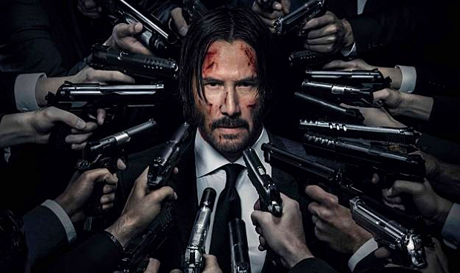
Matching music with aggressive motion.

Slide 9
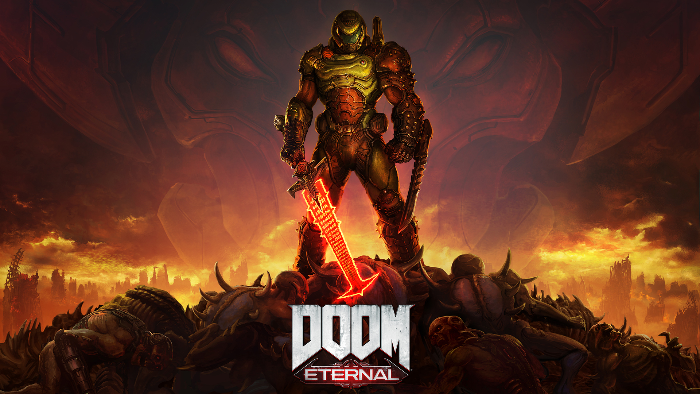
Matching music with aggressive motion.

Slide 10
The Beat Boxers.

Slide 11
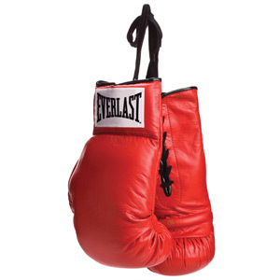
The Beat Boxers.

Slide 12
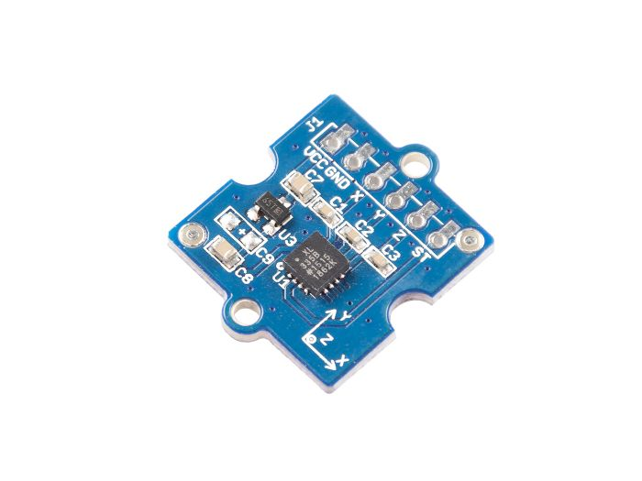
The Beat Boxers.

Slide 13
The Beat Boxers.

Slide 14
The Beat Boxers.

Slide 15
The Beat Boxers.

Slide 16
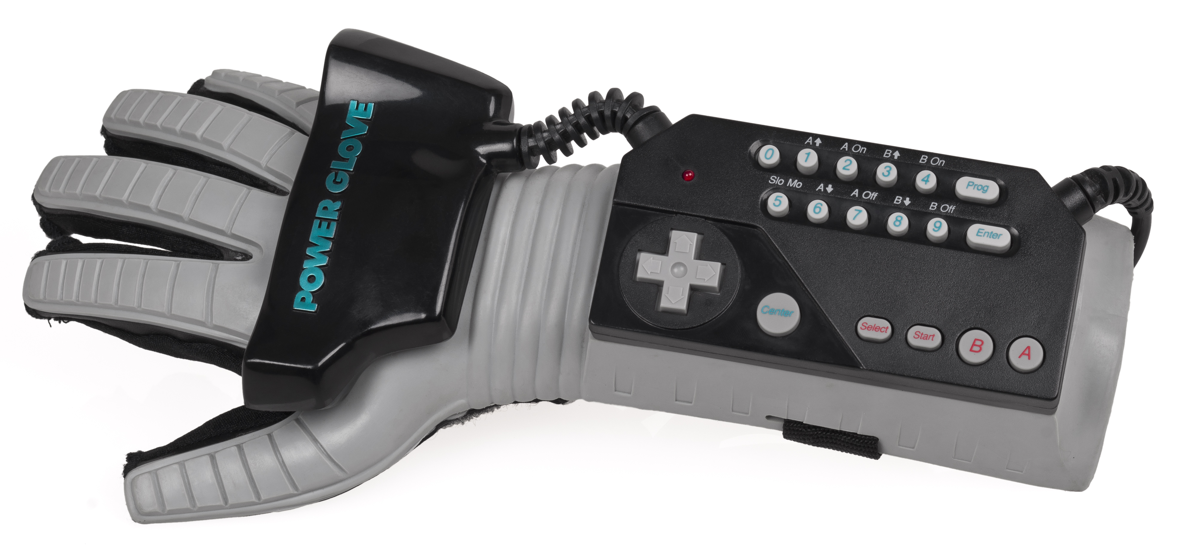
The Beat Boxers.
WOW!
Beat Boxers
So cool!

Slide 17
Why don’t we have those?

Slide 18
Why don’t we have those?
TECHNICAL DIFFICULTIES

Slide 19
Citations
Me
Myself
I
Pop culture
Cool video games
Keanu Reeves

